Slide 1
Array questions
Swift language

Slide 2
Which of the following statements prints the number of rows in matrix
var matrix = [[1,2,3,4], [5,6,7,8], [3,4,6,7]]
var row, col : Int
row = 5
col = 3
print(matrix.count)
print(matrix[0].count)
print(matrix.length)
print(matrix[0].length)
print(matrix.count)
print(matrix[0].count)
(C) print(matrix.length)
(D) print(matrix[0].length)

Slide 3
Which of the following statements prints the number of columns in matrix
var matrix = [[1,2,3,4], [5,6,7,8], [3,4,6,7]]
var row, col : Int
row = 5
col = 3
print(matrix.count)
print(matrix[0].count)
print(matrix.length)
print(matrix[0].length)
print(matrix.count)
print(matrix[0].count)
(C) print(matrix.length)
(D) print(matrix[0].length)

Slide 4

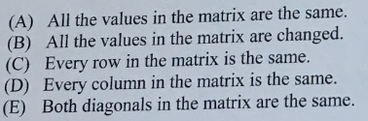
var matrix = [[11,22,33], [44,55,66], [77,88,99]]
var rows : Int
rows = matrix.count - 1
for n in 1 ... rows {
matrix[n][0] = matrix[n - 1][0]
}
print(matrix)

Slide 5
var matrix = [[11,22,33], [44,55,66], [77,88,99]]
for row in 1 ... 2 {
for col in 0 ... 2 {
matrix[row][col] = matrix[row - 1][col]
}
}
print(matrix)

Slide 6
var matrix = [[11,22,33], [44,55,66], [77,88,99]]
for row in 1 ... 2 {
for col in 0 ... 2 {
matrix[row][col] = matrix[row - 1][col]
}
}
print(matrix)

Slide 7
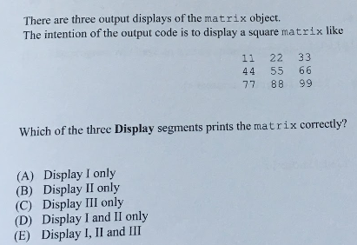
Which of the three display segments prints the matrix correctly?
var matrix = [[11,22,33], [44,55,66], [77,88,99]]
//Display 1
for row in 0 ... 2 {
for col in 0 ... 2 {
print(matrix[row][col], terminator:" ")
}
print()
}
//Display II
for p in matrix {
for col in matrix[0] {
print(col,terminator :" ")
}
print()
}
//Display III
print(matrix)

